Slide 1


Thermal Regulation through PID Control
Jake Tsuyemura
University of Hawaii at Manoa
Derek Kubo
John Kuroda
Ranjani Srinivasan
Smithsonian Submillimeter Array

Slide 2
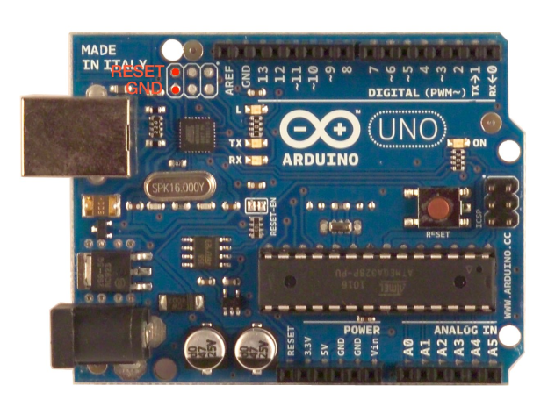

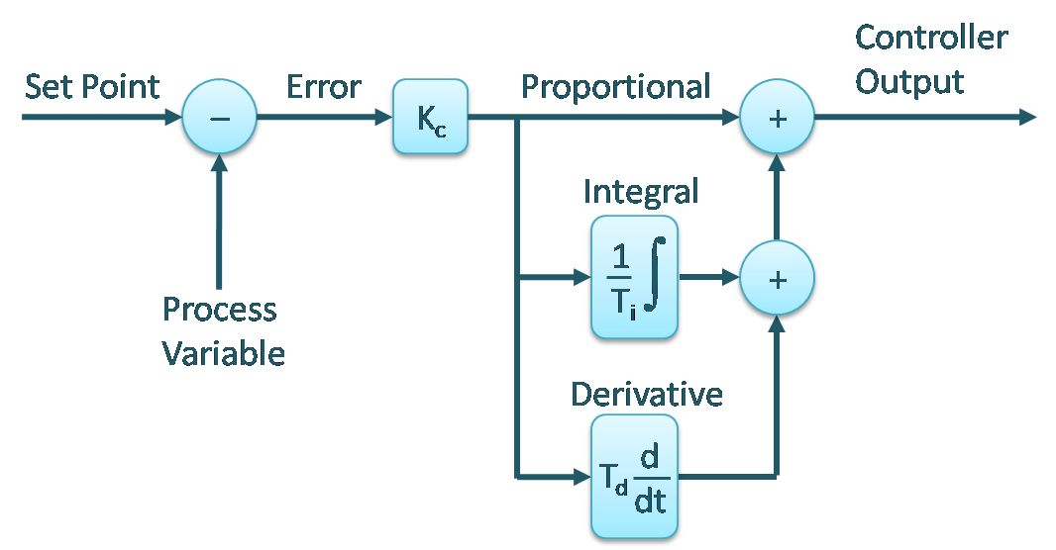
The Project/Motivation
Design PID Control system to regulate the temperature of sensitive equipment on the summit to within 1 °C peak-peak.
Previous temperature control system was unstable at certain temperatures
Implement this control system on any electronic enclosure
Use Arduino UNO microcontroller to implement PID and servo fanspeed
Perform Matlab Simulations using System Identification Toolbox/PID tool

Slide 3
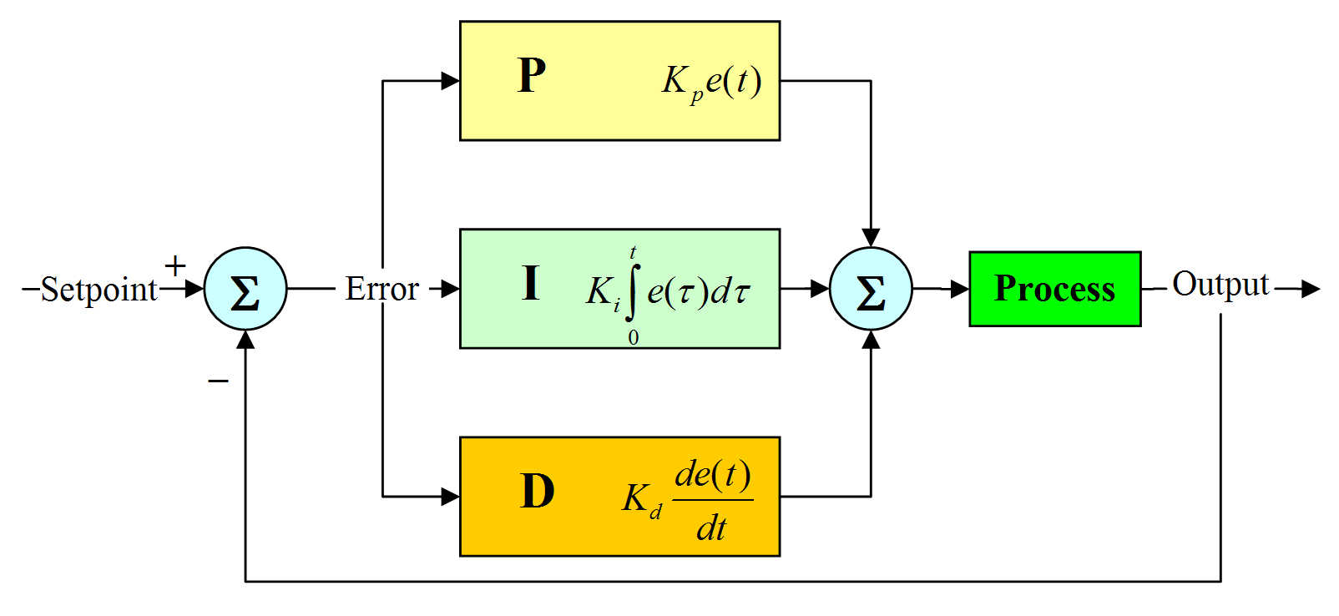

What is PID?
Proportional, Integral, and Derivative Control
Most common Control System
Easy to use
http://radhesh.files.wordpress.com/2008/05/pid.jpg

Slide 4
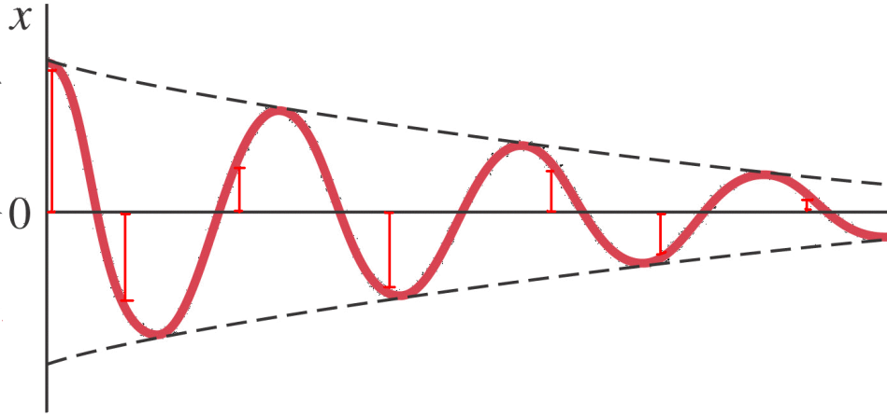
Proportional: Kp
Current error from Setpoint Defines Proportional Term

Slide 5
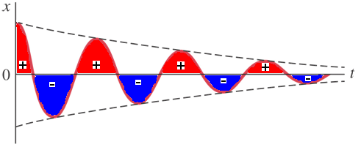
Integral: Ki
Sum of all previous errors defines Integral Term

Slide 6
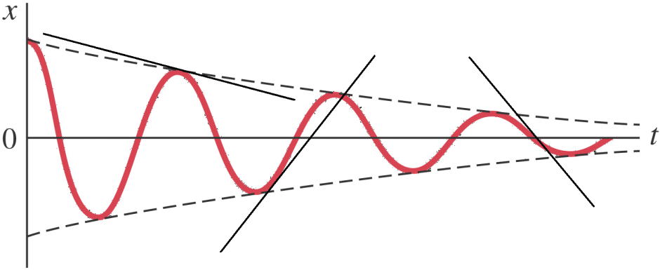
Derivative: Kd
Instantaneous rate of change defines Derivative Term

Slide 7
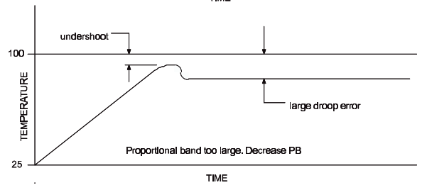
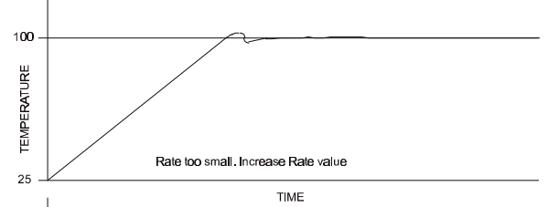
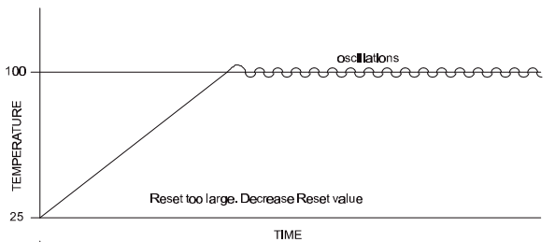
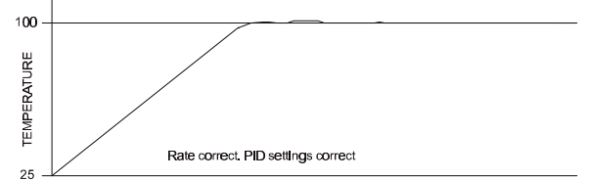
Tuning Coefficients
http://www.essproducts.com/download/PIDprimer.PDF

Slide 8
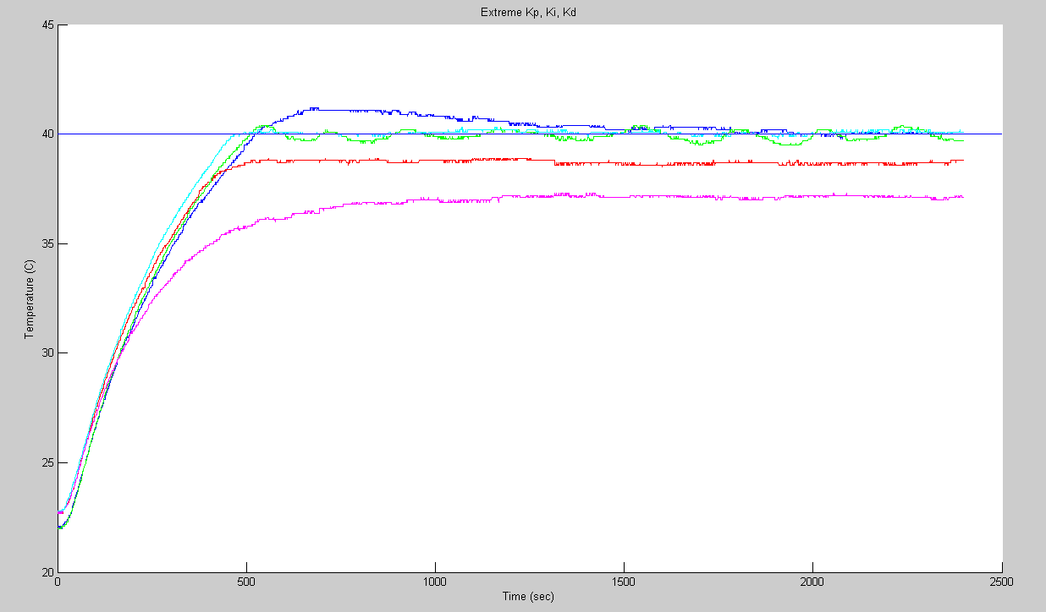
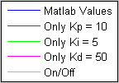
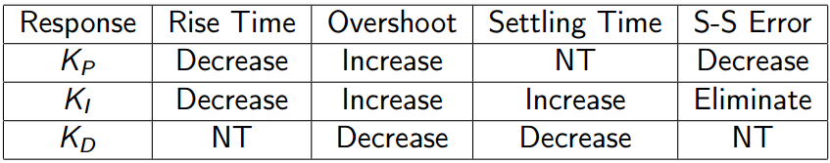
Extreme Kp, Ki, Kd Values
Setpoint: 40 ºC
Collected from Full scale Model over 40 minutes

Slide 9
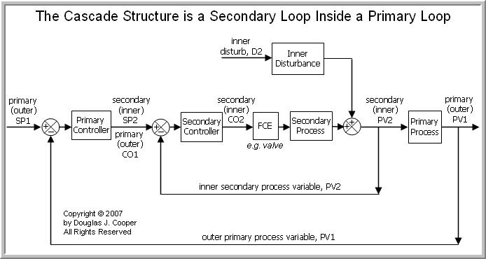
Cascaded Control
Cascade control is more complex
Primary PID loop controls setpoint of secondary PID loop
Responsive to fast/slow changes
Two sets of PID coefficients
http://www.controlguru.com/2007/090207.html

Slide 10
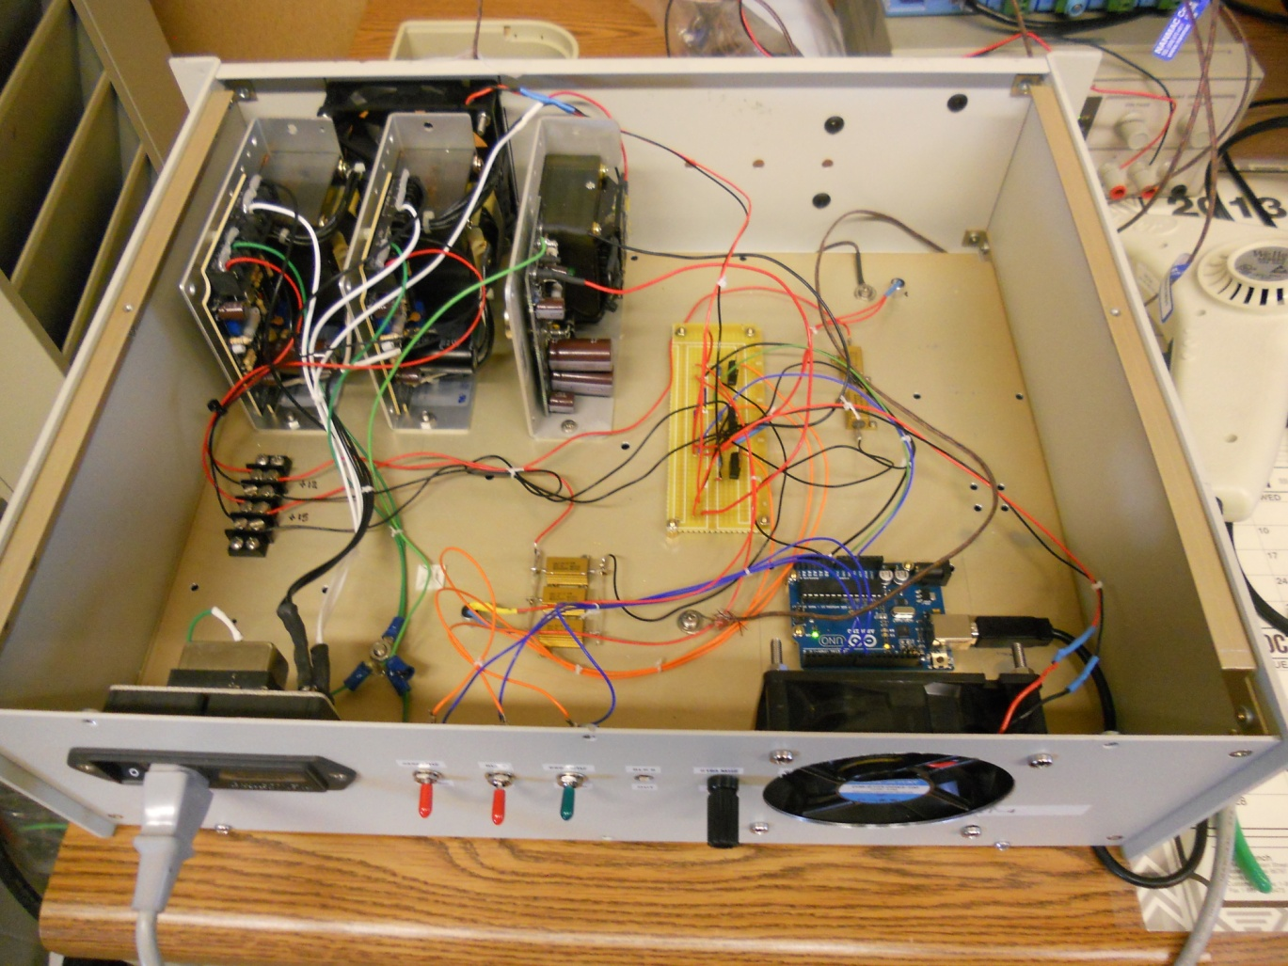
Full Scale Model
48 CFM Intake Fan
Far Thermistor
20W Heater
12V, 1.5W Power Supply
Voltage Divider/ Transistor Circuitry
Near Thermistor
Arduino UNO Microcontroller
20W Heater
48 CFM Exhaust Fan

Slide 11
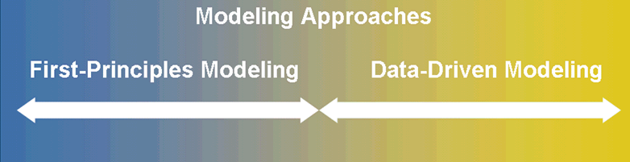
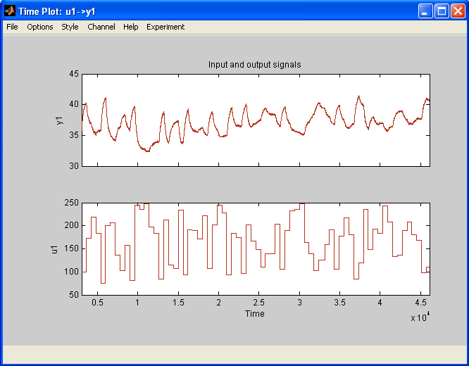
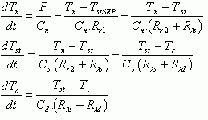
Two Approaches
https://www.mathworks.com/company/events/webinars/webinarconf.html?id=30317&language=en&confirmation_page&wfsid=4690229

Slide 12
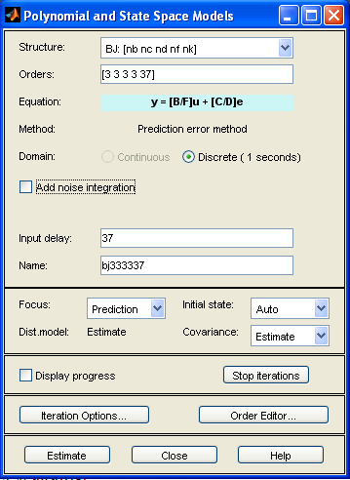
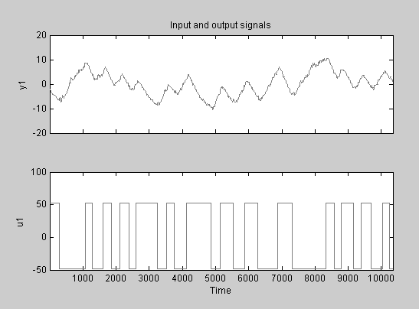
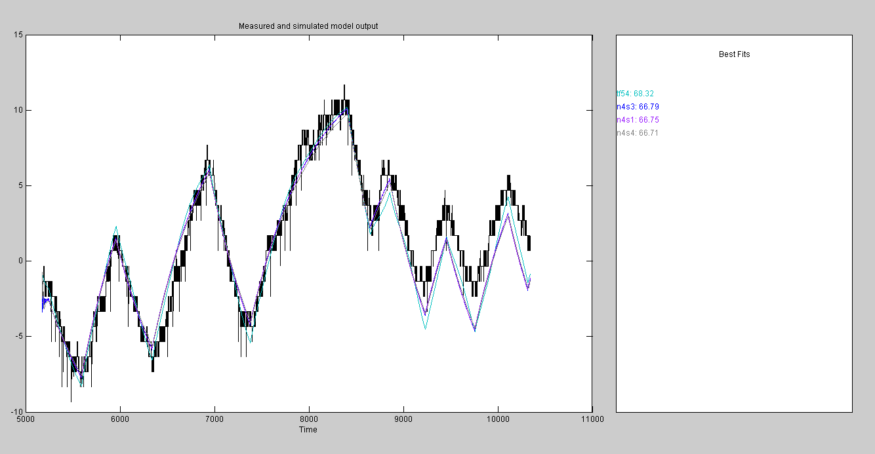

Modeling the System
Collected open loop data of system
Matlab’s System Identification Toolbox
Selected Box Jenkins Model Representation
Models noise with independent term
Matlab estimates I/O delay in first term
Estimated Transfer function fit 68% against validation data
http://www.essproducts.com/download/PIDprimer.PDF

Slide 13
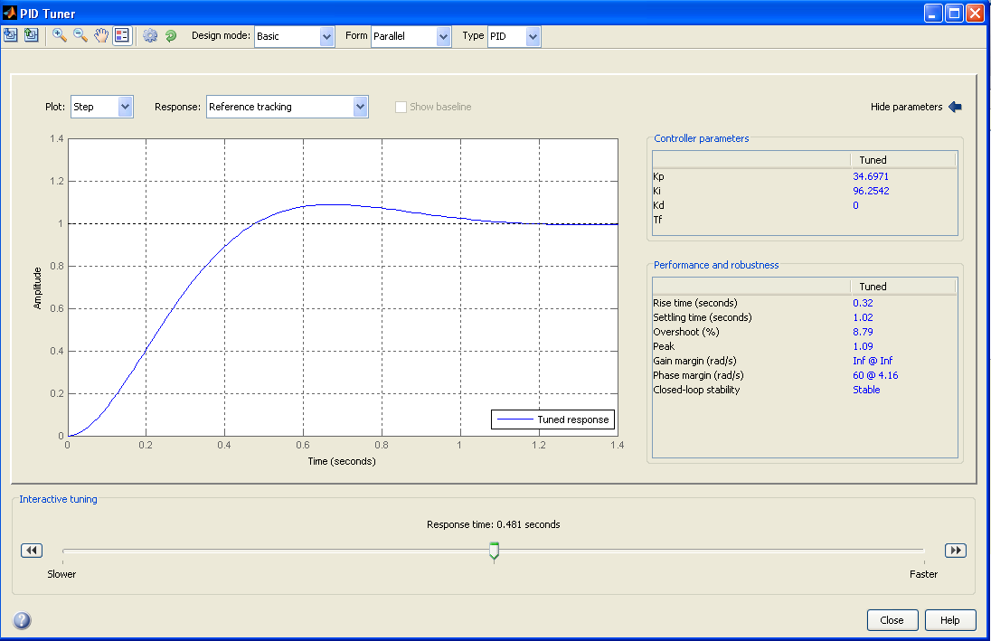
Matlab PID Values
Use Matlab’s PID tool to produce coefficient values
Adjust response time to match system
Chose PI controller to simplify tuning
Derivative contained too much noise
Simulated Coefficents:
Kp: 22 Ki: .255 Kd: 0

Slide 14
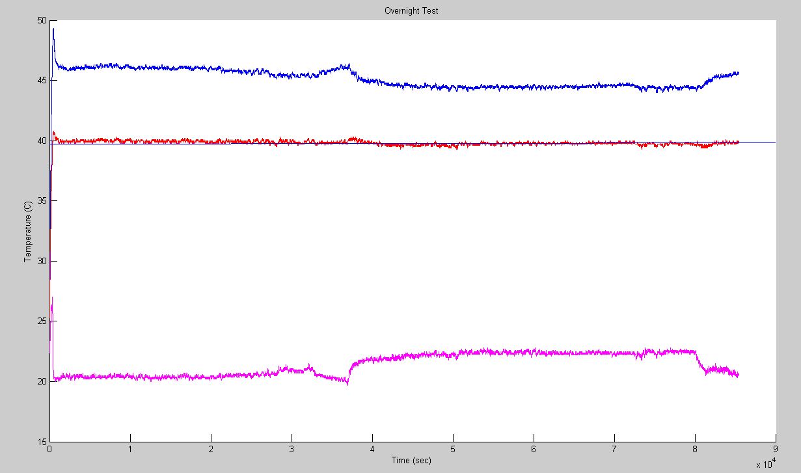
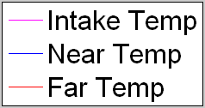
Single Loop Matlab Values
Setpoint: 40 ºC
AC turns off
AC turns on
Coefficents:
Kp: 22 Ki: .255 Kd: 0
Variance: 0.01288 Peak-peak: 1.009

Slide 15
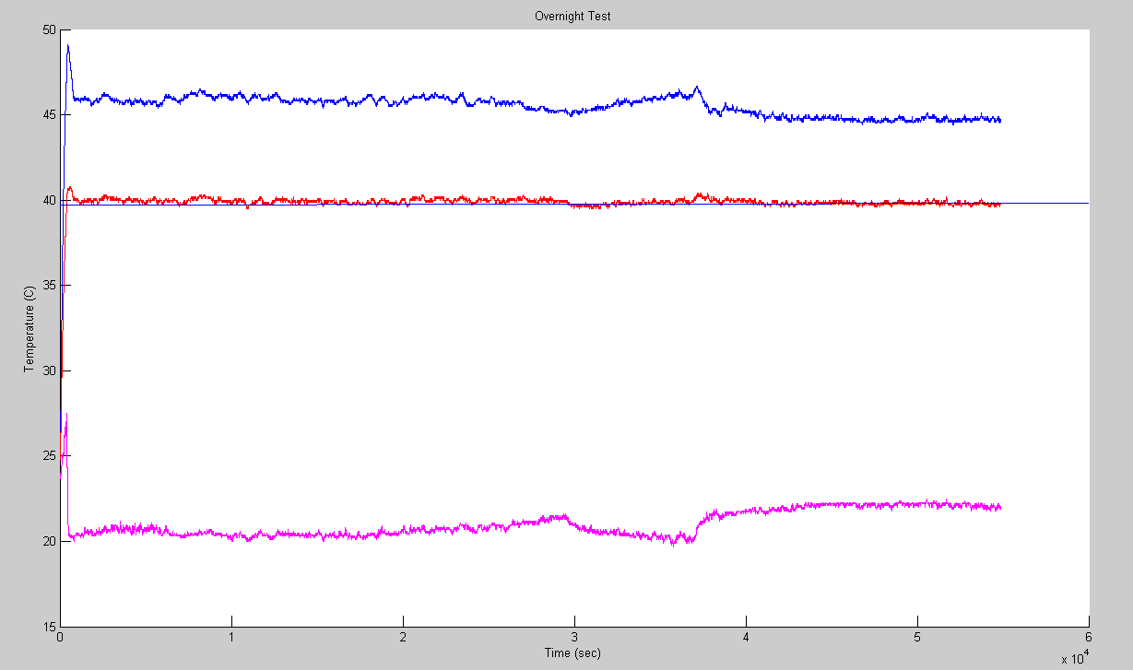
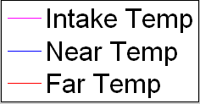
Large Scale Results: (Trial and Error)
Setpoint: 40 ºC
AC turns off
Coefficients:
Primary Loop: Kp: 10 Ki: 3 Kd: .2
Secondary Loop: Kp: 70 Ki: 10 Kd: 4
Variance: 0.033 Peak-Peak: 0.905

Slide 16
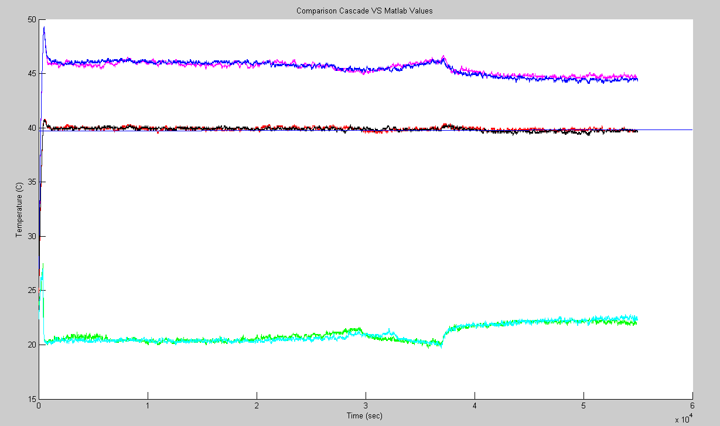
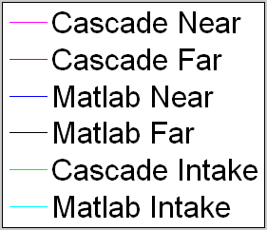
Cascaded Control VS Matlab Values
Setpoint: 40 ºC
AC turns off
Cascaded Control: Variance: 0.033 Peak-peak:.905
Matlab Values: Variance: 0.0128 Peak-peak: 1.009

Slide 17
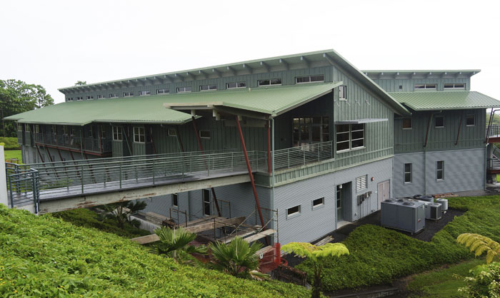
Conclusions
It is possible to manually tune a cascaded PID to within 1 ºC peak-peak
System Identification Toolbox is capable of producing an accurate Transfer Function of a real system
Matlab’s autotune PID tool can produce reasonable PID values
Matlab values and manually tuned values had very similar performance close to or within specification

Slide 18
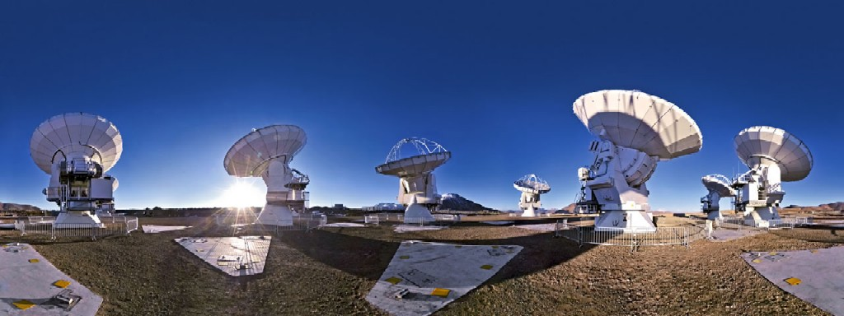


Acknowledgements
Special Thanks to:
Derek Kubo
John Kuroda
Ranjani Srinivasan
Support for the 2013 Akamai Internship Program and the Akamai Workforce Initiative is provided by: the National Science Foundation (AST#0836053); Air Force Office of Scientific Research (FA9550-10-1-0044); University of Hawaii; Thirty Meter Telescope Corp.; University of California, Santa Cruz; Kamehameha Schools.

Slide 19
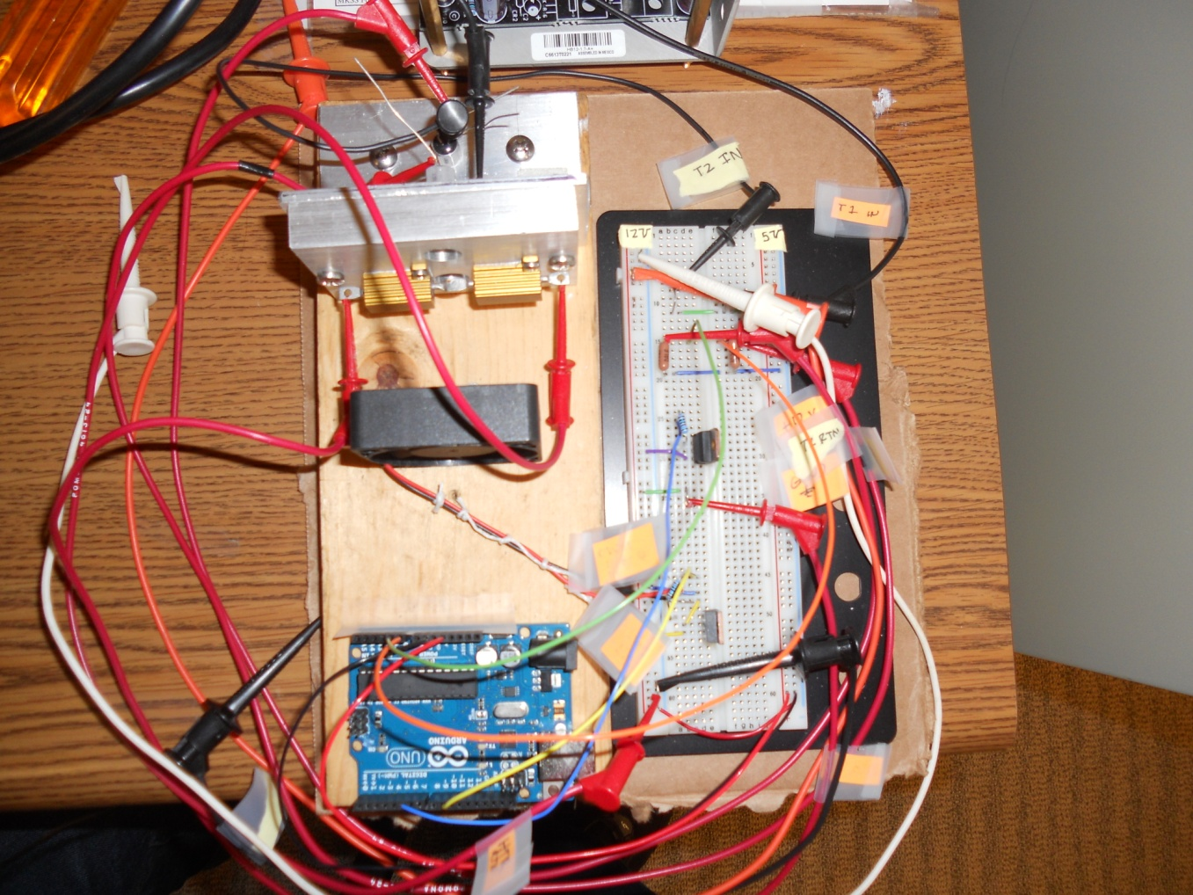
Small Scale Model
Far Thermistor
20W Heater
Near Thermistor
PWM Fan
Arduino Microcontroller
Voltage Divider/Transistor Circuitry

Slide 20
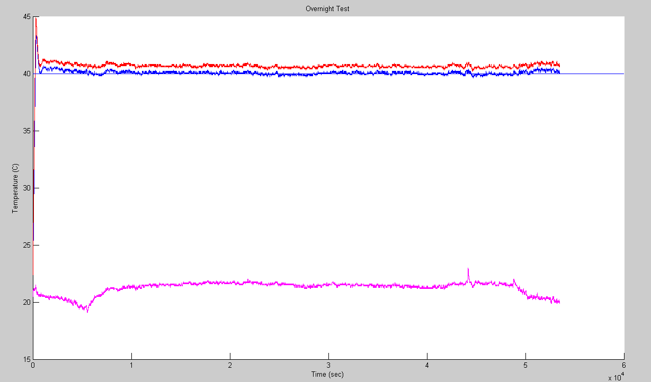
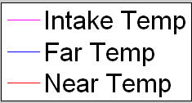
Small Scale Results: (Trial and Error)
Setpoint: 40 ºC
AC turns off
AC turns on
Coefficients:
Primary Loop: Kp: 3 Ki: .3 Kd: .2
Secondary Loop: Kp: 2 Ki: .5 Kd: .2
Peak-Peak: 0.51 Variance: 0.017

Slide 21
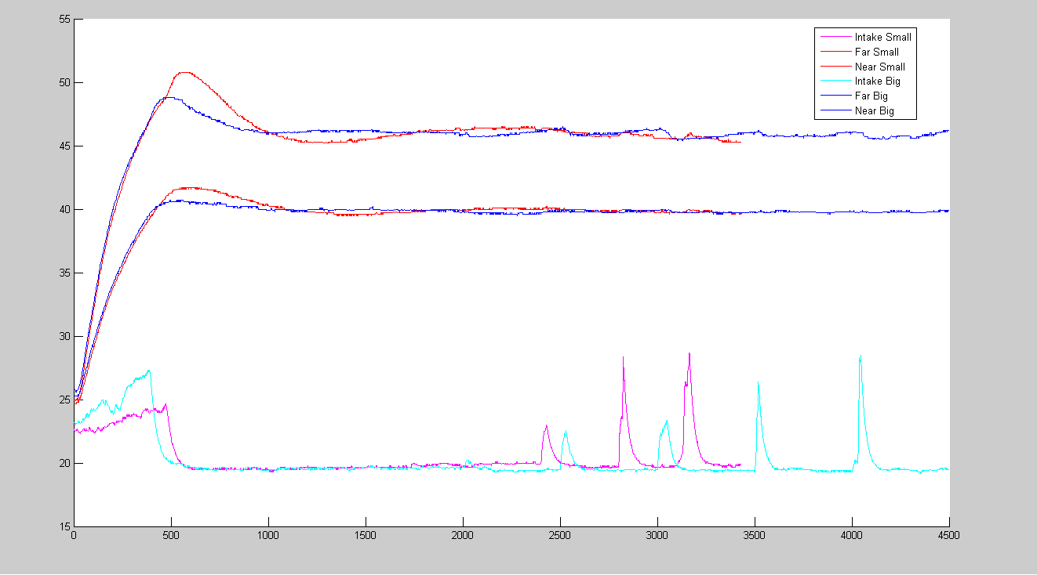
Disturbance Test
Blue: Large Scale Coefficients (+-1000)
Primary Loop: Kp: 10 Ki: 3 Kd: .2
Secondary Loop: Kp: 70 Ki: 10 Kd: 4
Red: Small Scale Coefficients (0-255)
Primary Loop: Kp: 3 Ki: .3 Kd: .2
Secondary Loop: Kp: 2 Ki: .5 Kd: .2

Slide 22
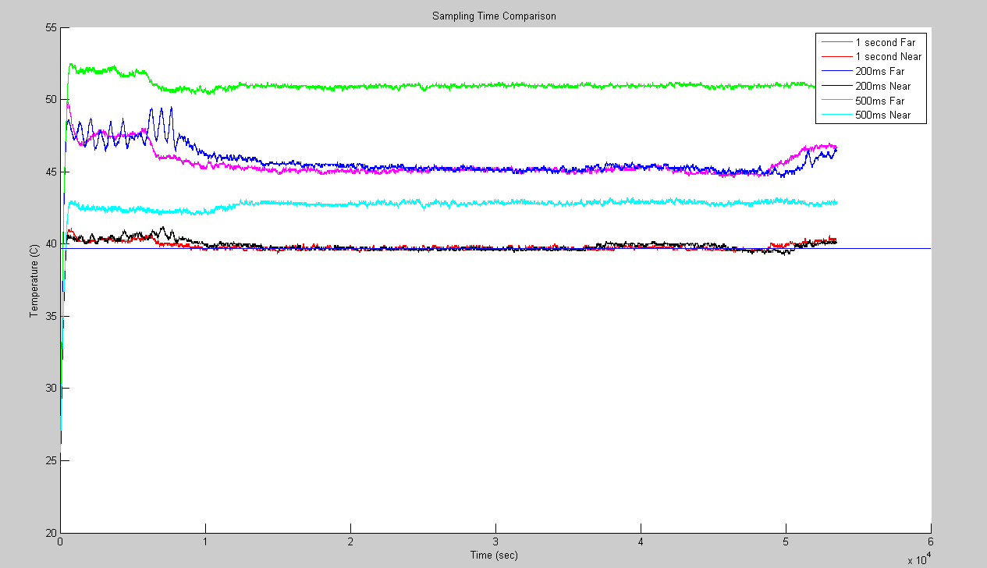
Effects of Sampling Time
Coefficients:
Primary Loop: Kp: 30 Ki: 3 Kd: .2
Secondary Loop: Kp: 70 Ki: 10 Kd: 4
Overnight Test with the same coefficents
Sampling times: 1000ms, 500ms, 200ms

Slide 23
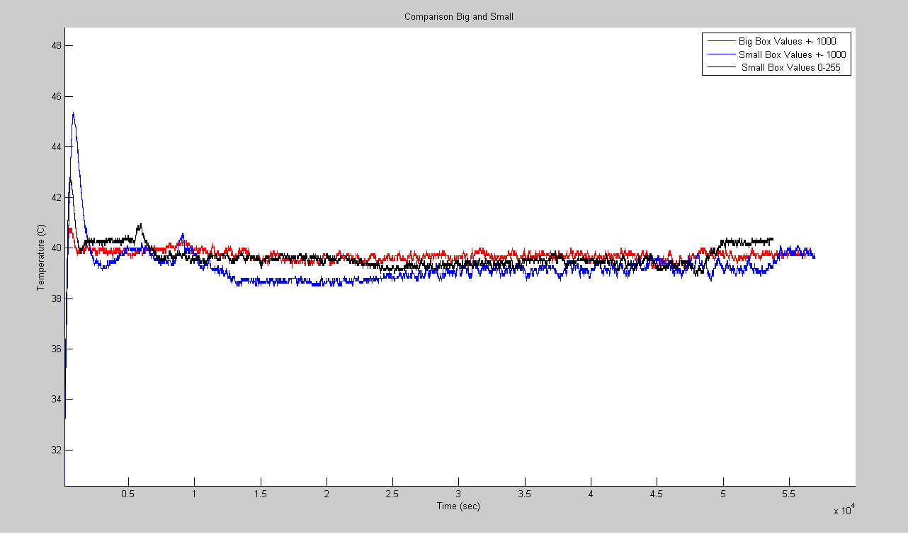
Comparing Big/Small Box Coefficients
Red: Big Box Values +- 1000
Primary Loop: Kp: 10 Ki: 3 Kd: .2
Secondary Loop: Kp: 70 Ki: 10 Kd: 4
Blue: Small Box Values +- 1000
Primary Loop: Kp: 3 Ki: .3 Kd: .2
Secondary Loop: Kp: 2 Ki: .5 Kd: .2
Black: Small Box Values 0-255
Primary Loop: Kp: 3 Ki: .3 Kd: .2
Secondary Loop: Kp: 2 Ki: .5 Kd: .2

Slide 24
Open Loop Recorded Data

Slide 25
System Identification Toolbox:
Box-Jenkins Model

Slide 26
Best-Fit Transfer Function
Best fit = 68.32%

Slide 27
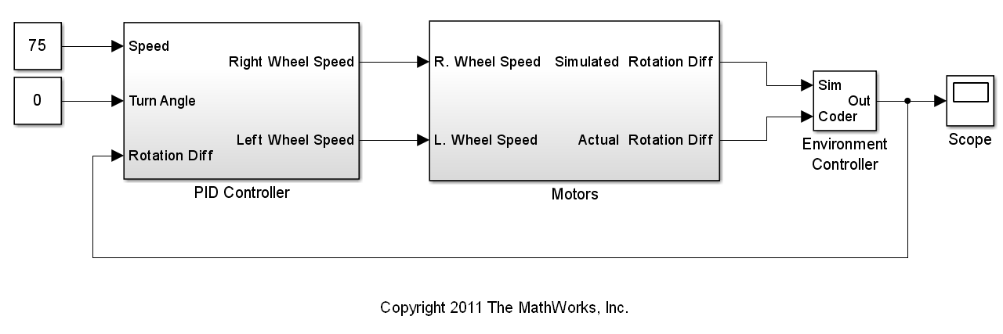
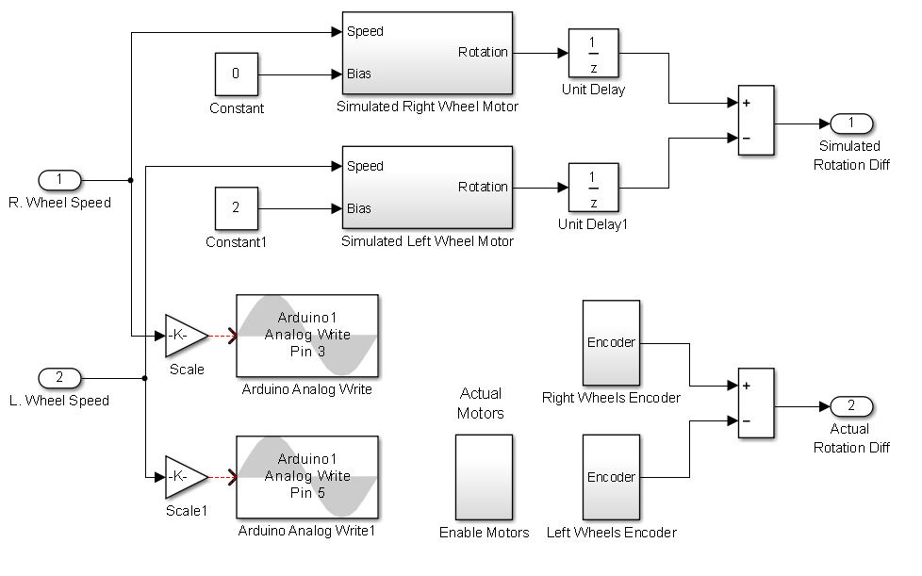
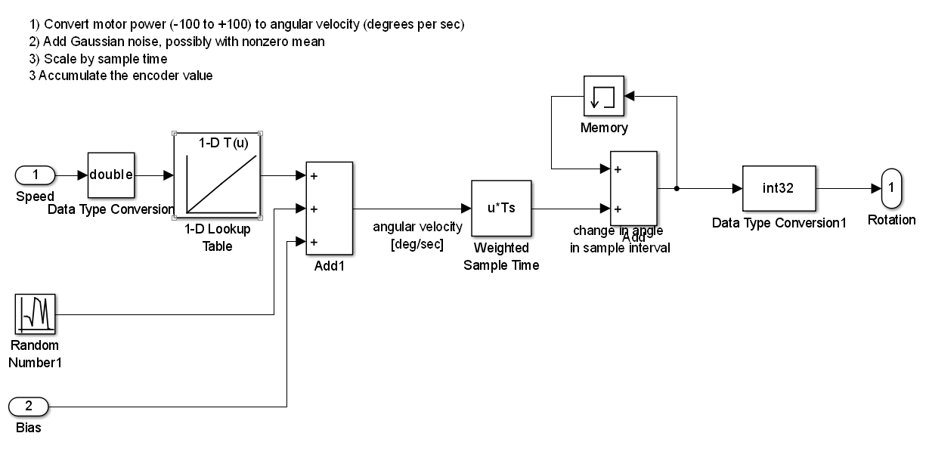
Simulink Modeling

Slide 28

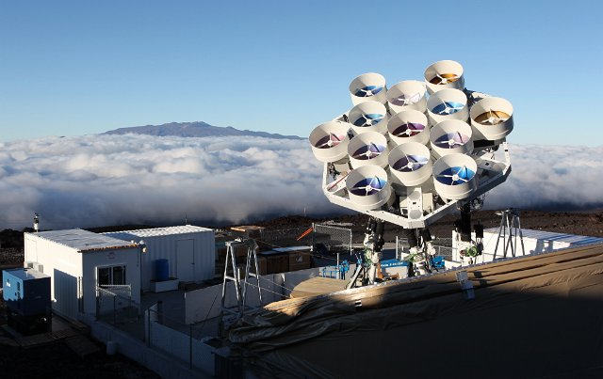
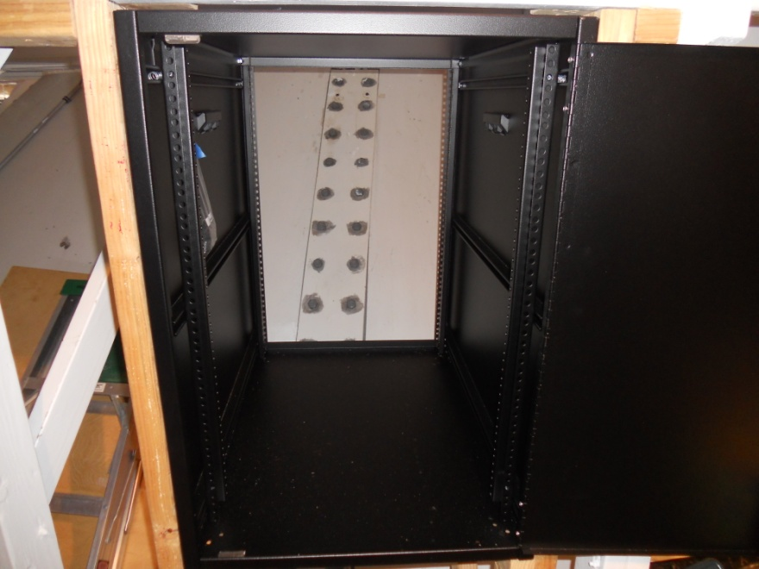
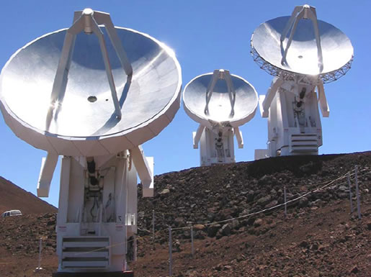
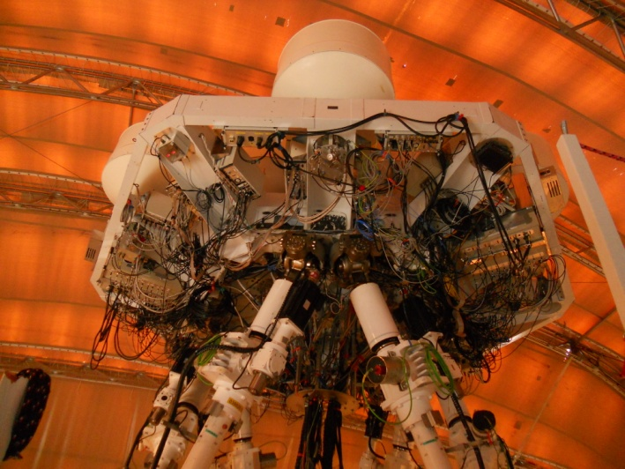
AMIBA/SMA

